Slide 1
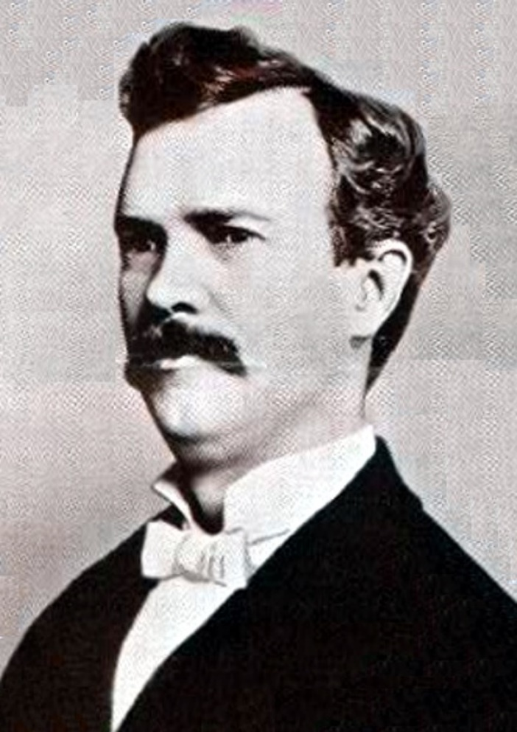
Жизнь и исследования Уильяма Берроуза
Аннануров Даниил Петрович 2 курс ИВТ 1.2

Slide 2
The life and research of William Burroughs
Annanurov Daniil Petrovich IVT 1.2

Slide 3
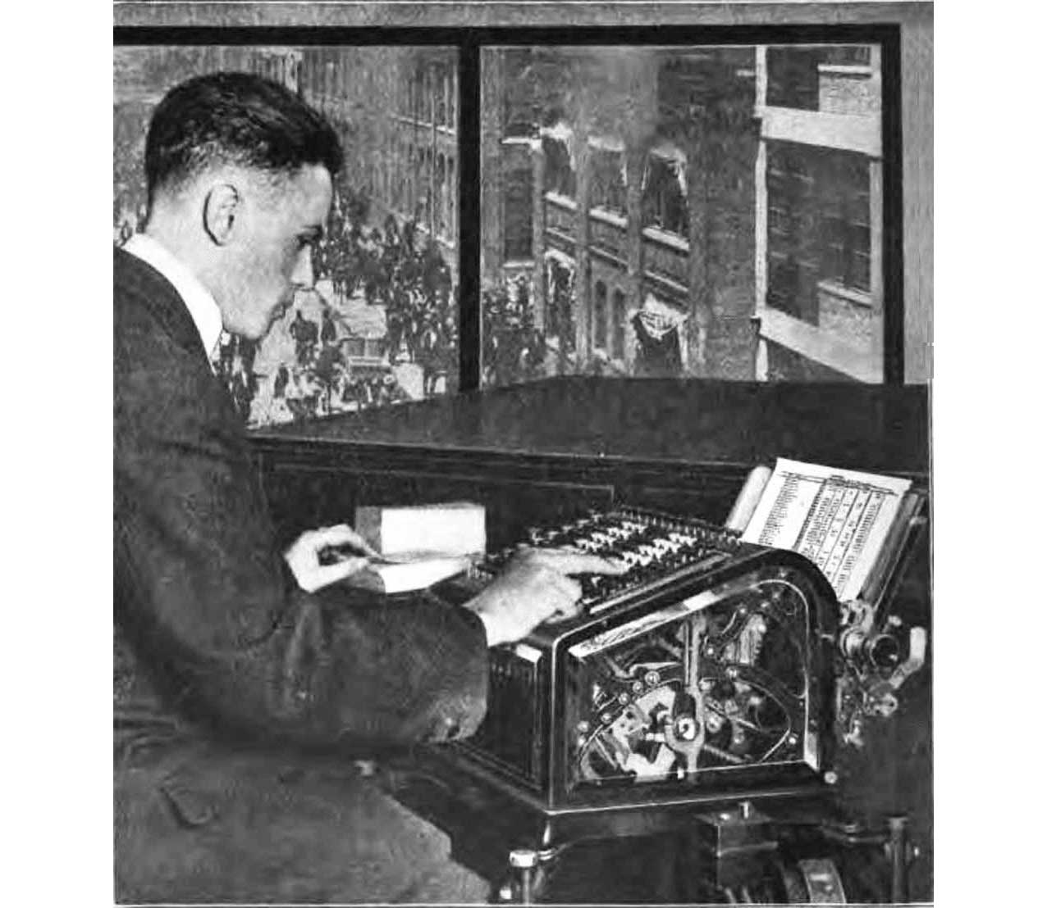
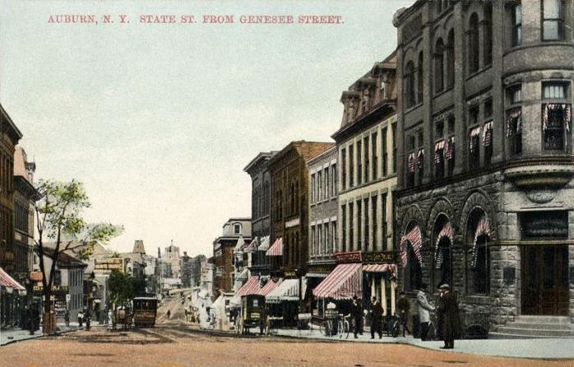
Personal Life
Bank clerk
Auburn, New York

Slide 4
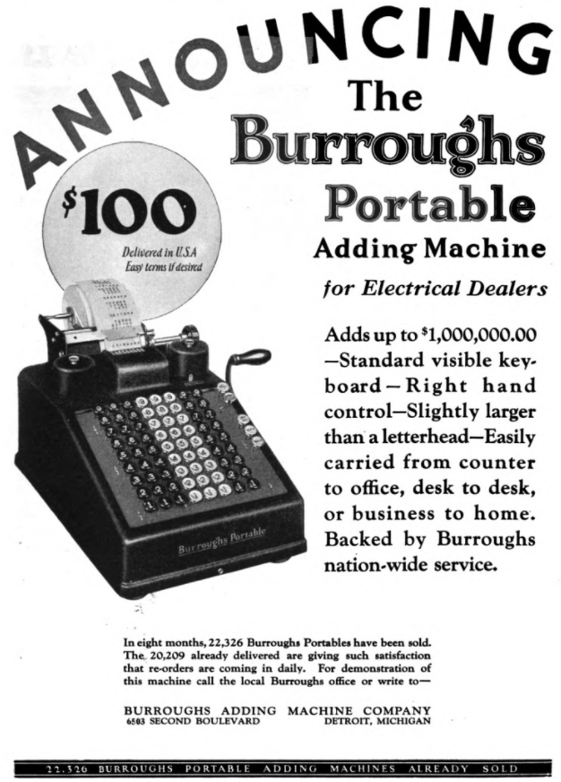
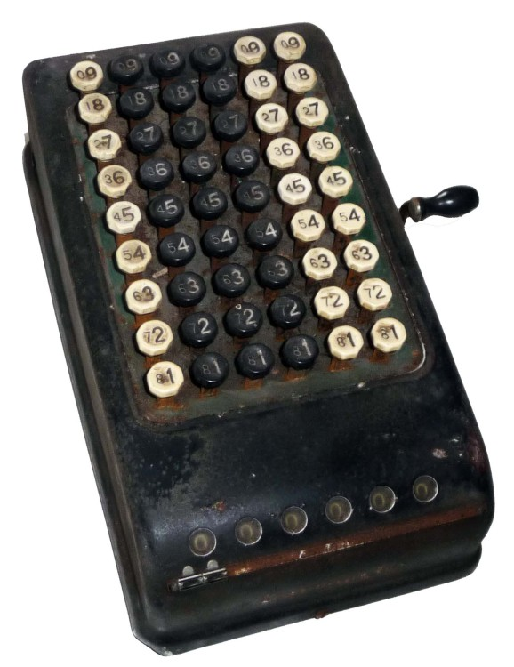
Burroughs portable adding Machine

Slide 5
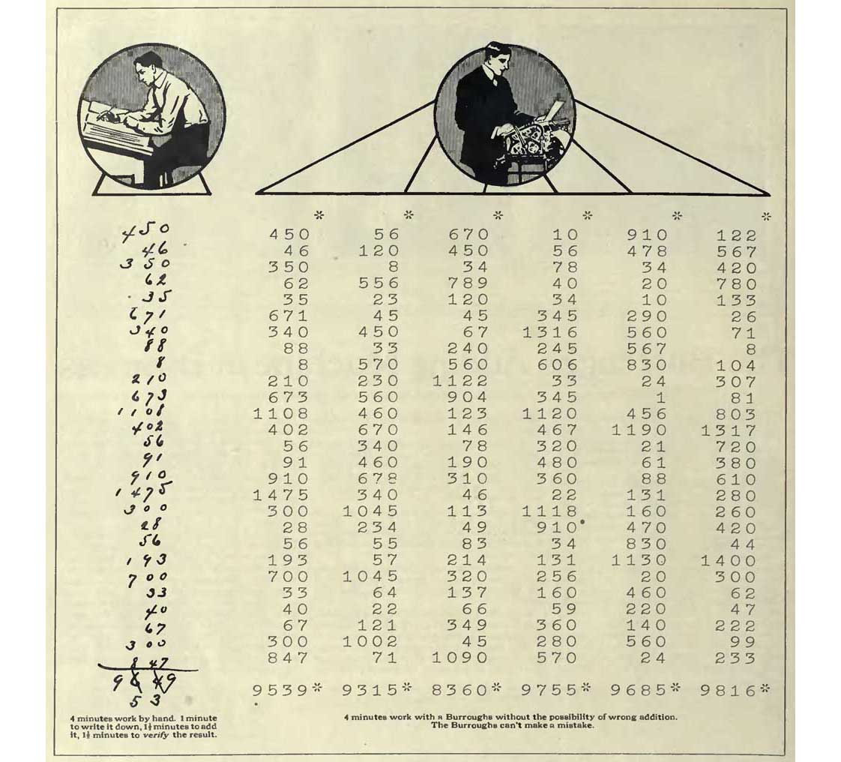
Marketing

Slide 6
Death
September 14, 1898

Slide 7
Sites
https://www.wikitree.com/wiki/Burroughs-1346
https://en.wikipedia.org/wiki/William_Seward_Burroughs_I
https://mycompanies.fandom.com/wiki/Burroughs_Adding_Machine_Company
https://habr.com/ru/articles/181752/
https://www.computinghistory.org.uk/det/6113/William%20Seward%20Burroughs%20patents%20his%20calculating%20machine#:~:text=21st%20August%201888%20William%20Seward,a%20more%20practical%20calculating%20machine

